Slide 1

CS144 Course Intro (Fall 2021)
Keith Winstein
Notes:
<number>

Slide 2
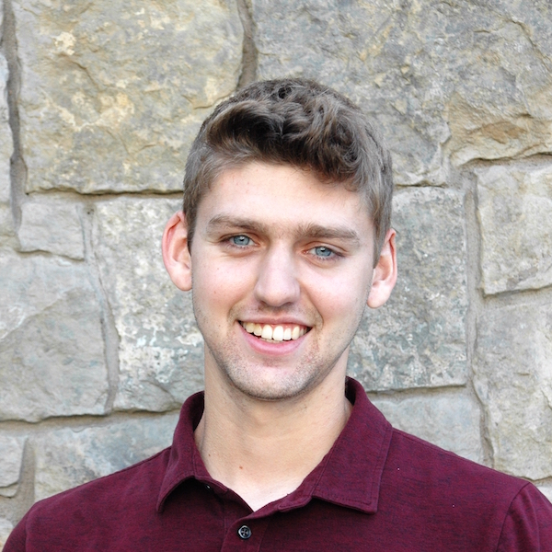
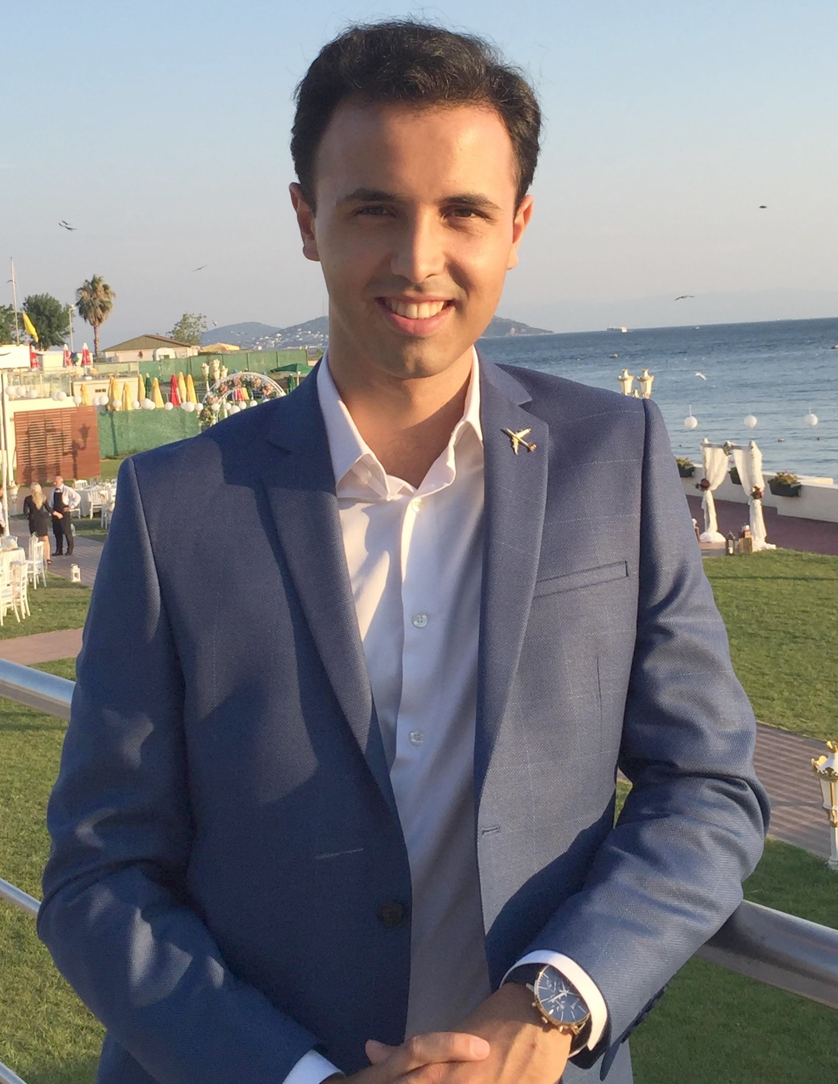

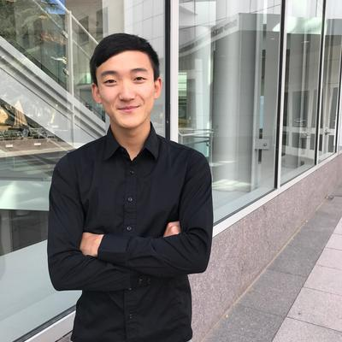
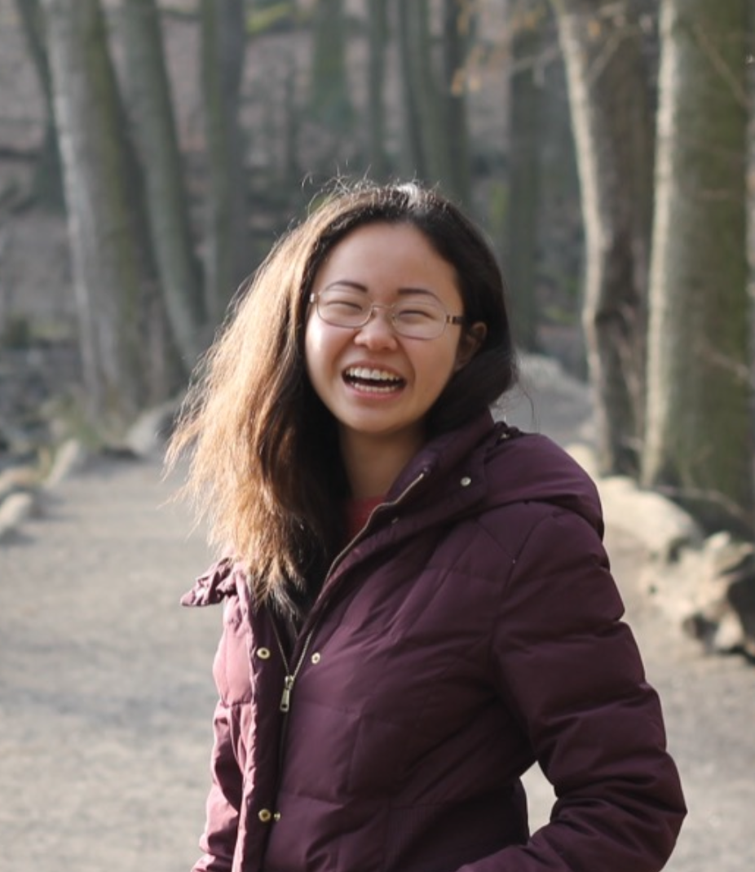
Head TA
Teaching Assistants
Nick Hirning
Serhat Arslan
Toby Bell
Richard Lin
Anna Zeng
<number>

Slide 3
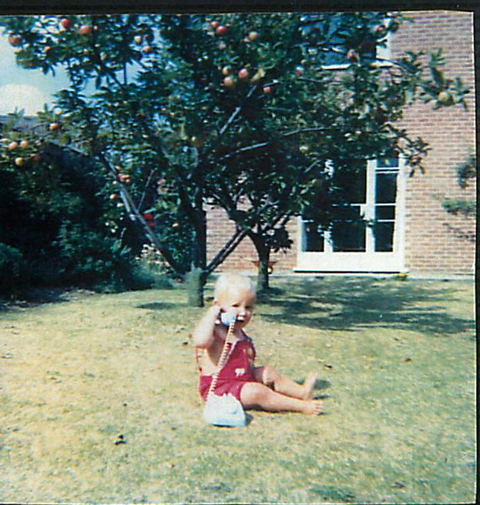
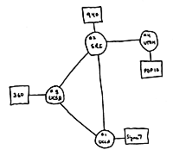
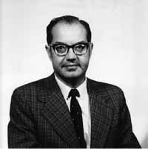
Four nodes connected (UCLA, SRI, UCSB, Utah)
Wireless Communications: 1964
“A network to survive nuclear attack.”
US Government starts “ARPANET” project
1st network connects two computers
Paul Baran
1964
1965
1966
1968
1969
Notes:
<number>

Slide 4
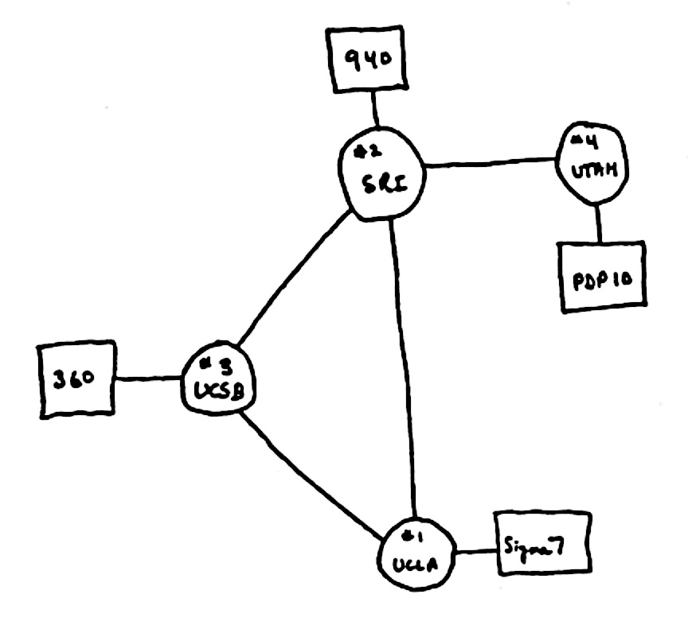

The Internet in 1969
“router”
“end host”
Also in 1969
“link”
Notes:
<number>

Slide 5
What did they use it for?
“router”
“end host”
“link”
Sending files between scientists: “Here is a big file of astronomy data!”
Email: “Where shall we have lunch today?”
Remote login to another computer.
Notes:
<number>

Slide 6
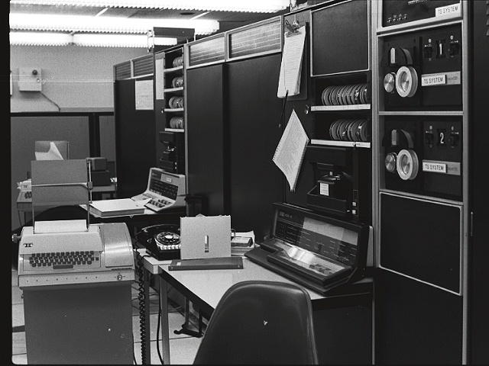
1971
First email typed here
“QWERTYUIOP”
…and printed here

Slide 7
“router”
1993
1,000,000 “end hosts”
“end host”
“link”
1988
10,000 “end hosts”
1969
4 “end hosts”
Network Systems: 1984
Notes:
<number>

Slide 8
Then in 1993 something even BIGGER happened!!!

Slide 9
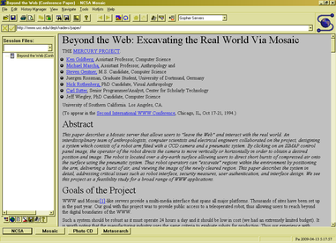
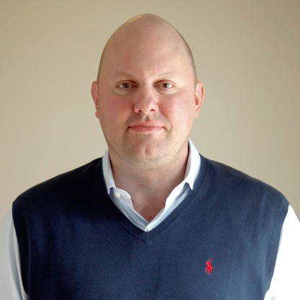
1993: The first web browser (Mosaic)
Marc Andreessen

Slide 10
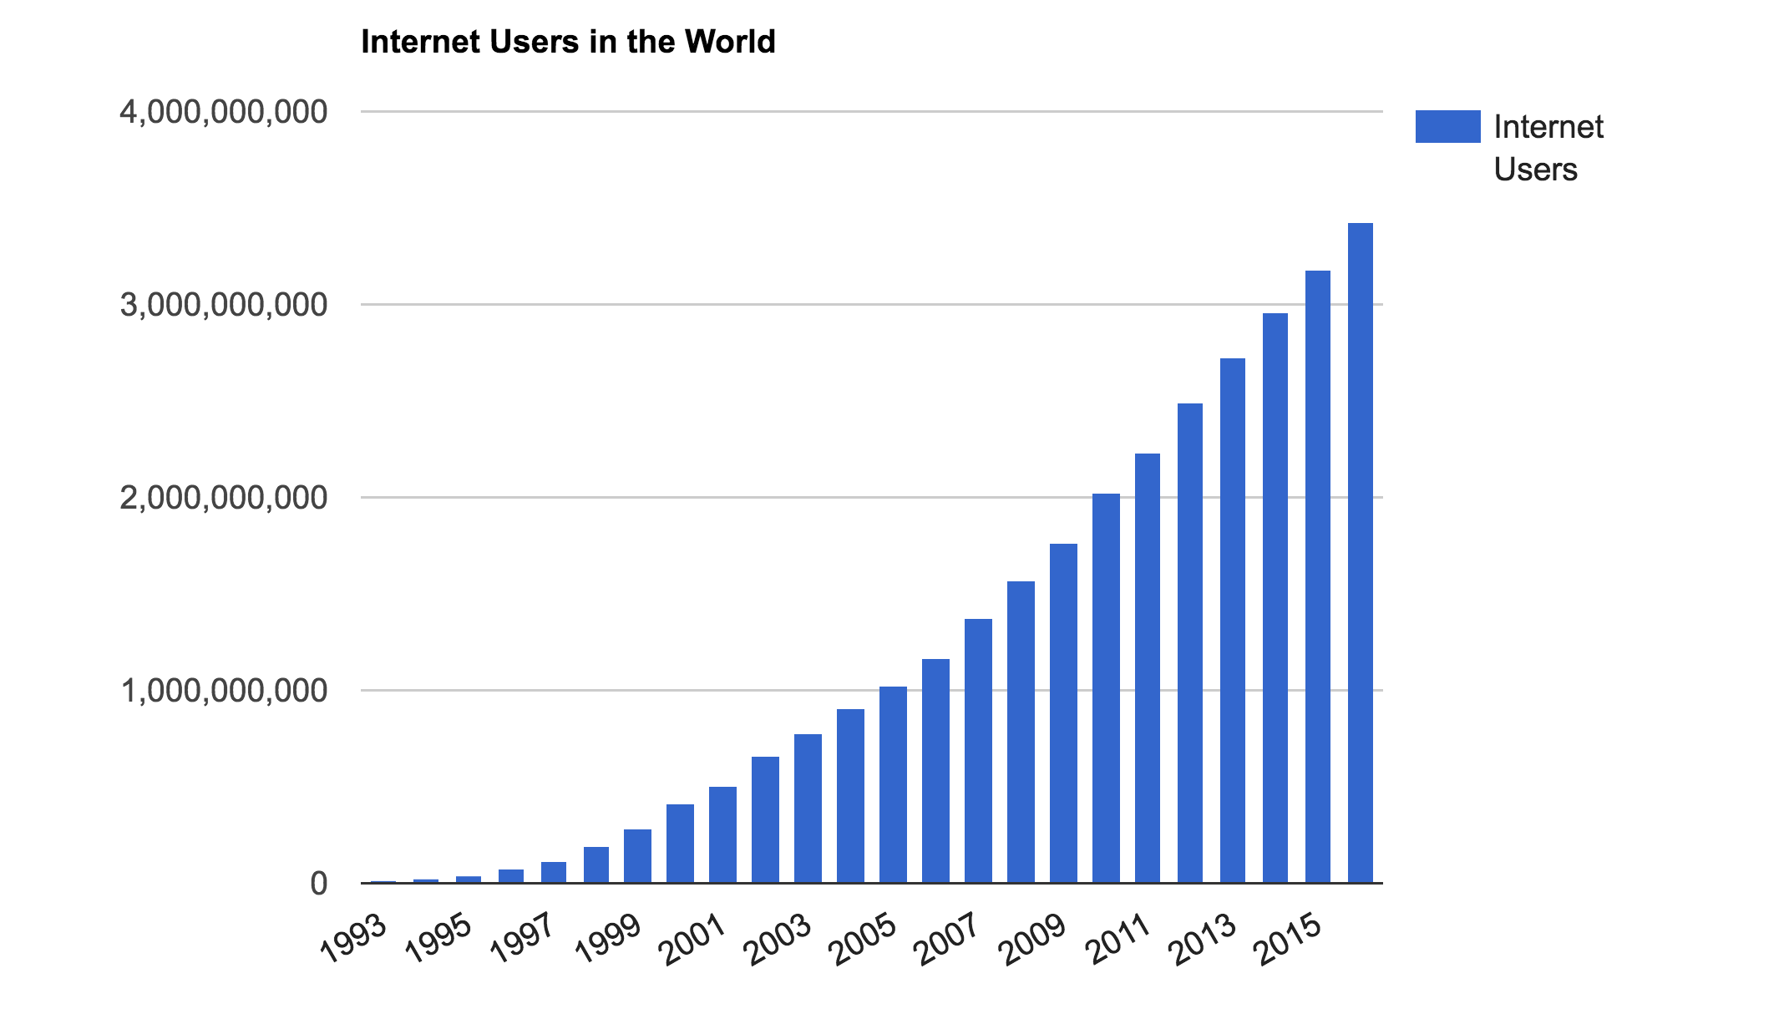
The number of Internet users in the world
3.6B people
~ 40% of world
Source: http://www.internetlivestats.com/
Notes:
Internet user = someone who has access to the Internet from home (by any device)
7.4B in the world, so still less than 50% of people.

Slide 11
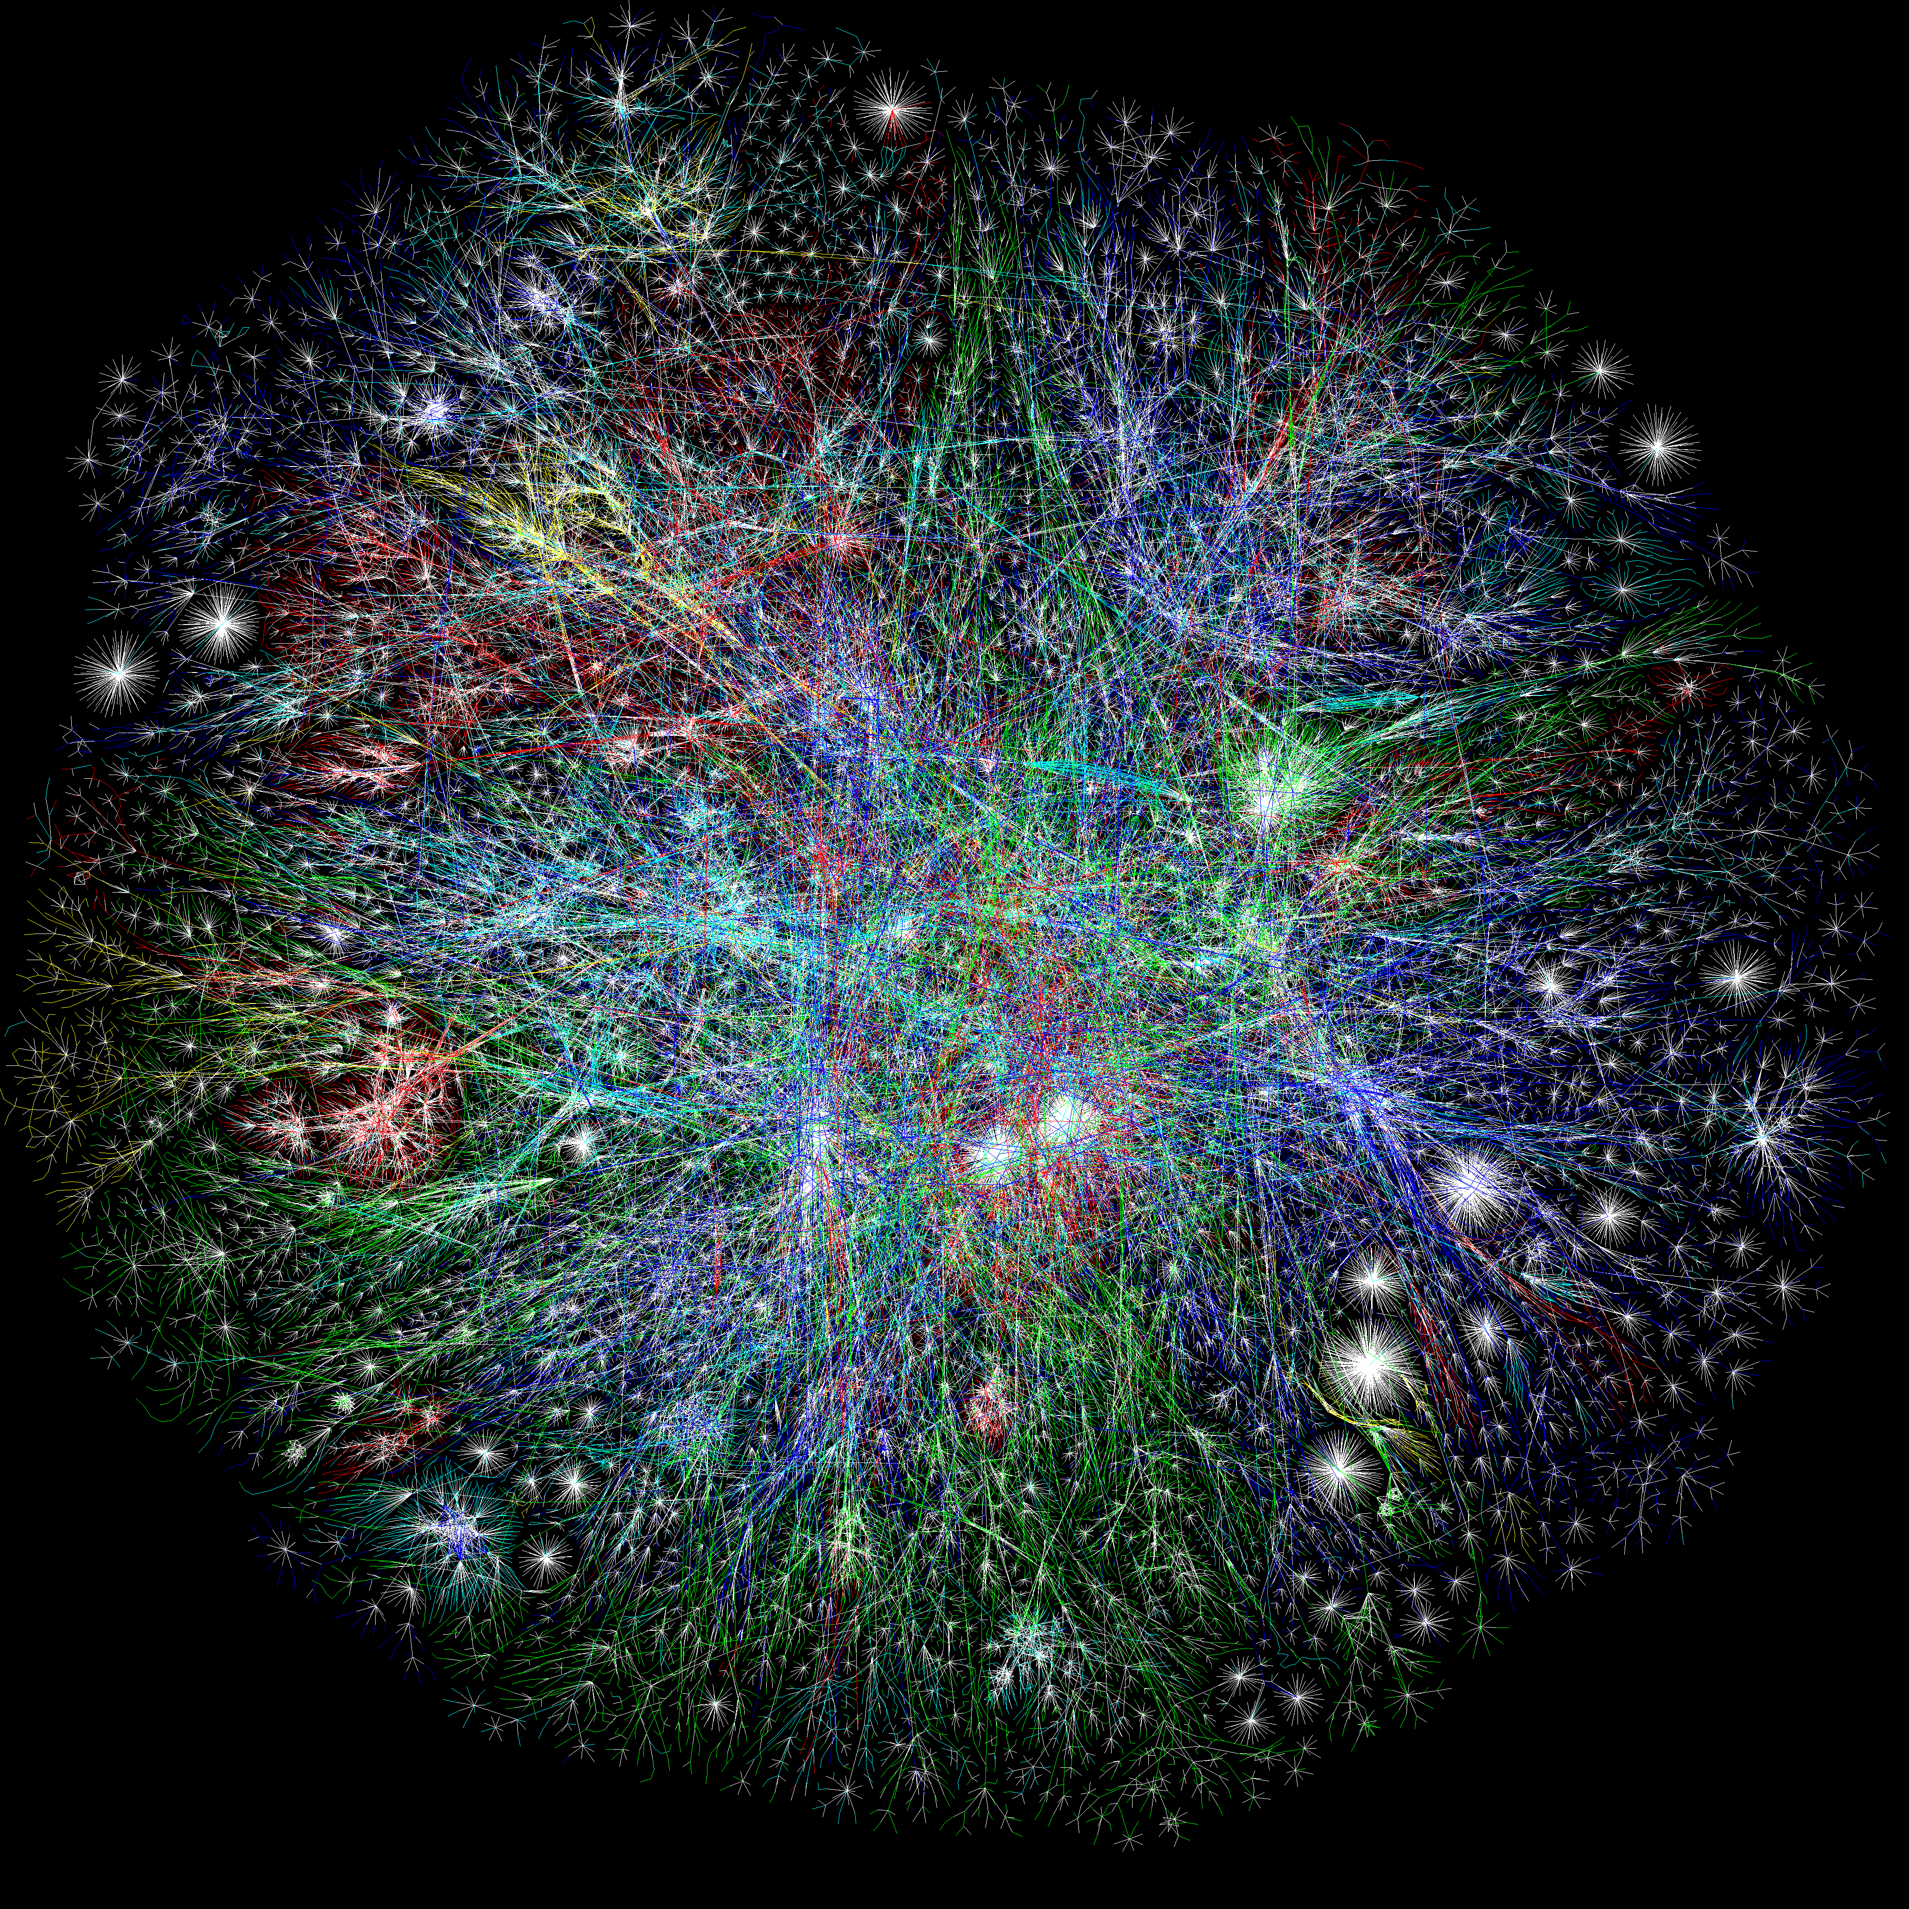
Notes:
<number>

Slide 12
How does it all work?
Why was it designed this way?

Slide 13
CS144
Isn’t it really difficult….?

Slide 14
Goals
To learn how the Internet works.
To learn why the Internet was designed this way.
To learn how to use the Internet.
To build some significant pieces of the Internet.
To learn the underlying principles and technologies of networking.

Slide 15
Class overview
CS144 is a fast-paced lab class.
Each week has TWO lectures and ONE lab session. Lectures generally end at 3 p.m.
The is divided into week-long units, devoted to a particular topic. e.g. the 1st week is about Basic Principles, then (2) Transport, (3) Packet Switching, (4) Congestion Control, (5) Routing, (6) Lower Layers, (7) Applications, ...
There is ONE BIG LAB ASSIGNMENT (“you build most of the Internet”) with 8 “checkpoints,” #0 through #7.

Slide 16
Laptops
We discourage laptop use in class, especially use that will distract others behind you.
Except for specific in-class exercises (we will ask you to bring your laptop).

Slide 17
How we calculate your grade
Participation/lecture 15%
Helping others on Ed or in the lab sessions
In-lecture exercises and occasional quizzes
Good questions in lecture
The lab 45%
Correctness (as of end of class): 36%
Checkpoints 0-7 subjective grades: 9%
Quizzes & Exams 40%
Midterm (Nov. 3): 20% (~50mins, in-class)
Final: 20% (~120mins, in scheduled slot)
Q: “What does it take to earn an A?”

Slide 18
How we calculate your grade
Programming assignments 50%
8 Labs (5% or 10% each)
Get started!!!
Quizzes & Exams 50%
End-of-unit quizzes 10% (online quiz in video weeks)
Midterm: 20% (50mins)
Final: 20% (50mins)

Slide 19
Exam Policy
Exams are closed-book, closed-note, closed-laptop etc.
But you may bring 2 double-sided sheets of 8.5” x 11” paper of your own design to the Midterm and Final.
<number>

Slide 20
COVID
This quarter may suck present lousy circumstances. :-(
My job is to help you learn. I really want that to happen.
We’re going to have to react to curveballs and we will do our best.
If you have to quarantine, we will be there for you (online) to help you avoid falling behind.
<number>

Slide 21
Lab
Programming is in modern C++
CS110 is a prerequisite.
You really want to go to the lab sessions
… and have started the lab before you go.
Late policy:
Final correctness deadline is end of term (but don’t wait)
Checkpoint deadline each week (first one: next Tuesday)
To receive a subjective/style grade and feedback, need to submit checkpoint by deadline. This is for the CAs’ sanity.
You can submit any checkpoint up to 2 days late, with subjective grade capped at 67%.
<number>

Slide 22
Win Certificates!!!
Your name here
For each Lab:
Certificate for BEST submission,
Certificate for FIRST CORRECT submission.
<number>

Slide 23
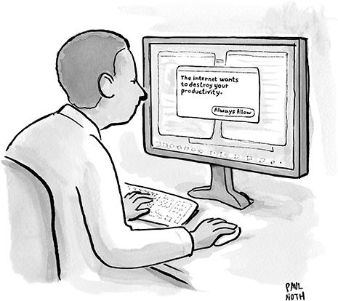
Workload
This is a 4-unit workload, which means a workload of about 12hrs/week
Our estimate based on previous years
Class time: 3hrs/week
Labs: Avg 6hrs/week
wide variance between checkpoints and between students
read the whole checkpoint BEFORE coding
Average overall ~12hrs/week

Slide 24
Contact
For anything non-private: Ed
If private: Private Ed posting, or email cs144-staff@cs.stanford.edu
If it’s personal (e.g. a medical emergency):
email Keith keithw@cs.stanford.edu
(If it’s a mega-emergency, Keith’s cell phone number is on his Web page.)

Slide 25
The Honor Code
We take it seriously and we expect you to take it seriously too.
Last year was a bad year with several CS144 students getting into a lot of trouble ☹
None of them had set out to cheat: At the last minute, they copied an assignment off the web, then tried to modify it. Or they colluded on an exam. It doesn’t work!
We use special tools to compare solutions against current and previous years and solutions we find on the web.
Please, let’s have a zero-violation year.

Slide 26
The Honor Code
Permitted Collaboration: The following items are encouraged and allowed at all times for all students in this class:
Discussion of material covered during lecture, problem sessions, or in handouts
Discussion of the requirements of an assignment
Discussion of the use of tools or development environments
Discussion of general approaches to solving problems
Helping others at the lab session (without looking at code!)
Discussion of general techniques of coding or debugging
<number>

Slide 27
The Honor Code
Unpermitted Collaboration: All submissions must represent original, independent work. Some examples of activities that do not represent original work include:
Copying solutions from others or knowingly allowing others to copy your solution.
Use of solutions posted to websites is prohibited.
Placing your source code in a public repository where others can copy it is unpermitted collaboration.
Debugging code for someone else.
Collaborating on or discussing the online graded quizzes before you have completed them.
Honor code exercise: can you stump the teaching staff?
<number>

Slide 28
What to do next
Look around and get familiar with https://cs144.stanford.edu
Start setting up your VM for Lab 0! It is due next Tuesday.
See you tomorrow @ 5:30 p.m. at the lab session.
<number>
Notes:
<number>

Slide 29
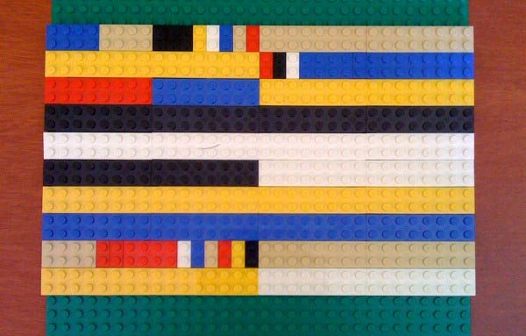
TCP/IP Header Formats in Lego

